Slide 1
Introduction
In outlets the beer glass is one of the most important touchpoints for the consumers. When combined with the perfect serving ritual, it elevates the drinking experience for the consumer. The perfect glass can be a full sensory experience, from the sound of the beer rushing into the glass to the sight of the foam forming on top of the liquid. The chilled touch of the glass on the lips before the foam subsides for an aromatic experience followed by the taste of the beer.
Developing the perfect glass requires careful attention. The cost for developing new glassware is high and can take a long time. As a result, it is difficult to quickly change to a new glass design once it is in the market.
This document is to help in development glassware

Slide 2
Glassware development considerations
Overall design
Type of glass (Bespoke, Off-the-Shelf, modified Off-the-shelf, mouth blown)
Technique (Blown, Pressed)
Material (Soda-lime, crystalline, borosilicate)
Virgin or Recycled
Glass size (number of moulds required)
Tempered/toughened
Decoration
Nucleation
Stackability / Pilability
Giftpack
Transport pack/size

Slide 3
Main flow
Overall flowchart
Choices:
Bespoke or Off the shelf/catalogue
Cost, leadtimes, MOQ, flexibility, options to leave undecorated
If bespoke glass
Overall design limitations (Mould openings, size limitations factory,
Technique (blown/pressed, stemware:bowl/stem)
Type of glass (stemware vs tumbler vs tankard
Glass: sodalime, borosilicate, crystal, crystaline
Virgin or recycled
Glass sizes
Tempering/thoughening
Stackability
Off the shelf
Options to modification
Type of glass
Considerations
Decoration
Types of decoration
Nucleation
Other
Packsizes
Giftboxes
Watchouts during development checkpoints
Use of 3d models in development
Technical drawing checks
Trial sample review
Production start
After launch

Slide 4
Bespoke or not
Bespoke glass
Overall design limitations (Mould openings, size limitations factory,
Technique (blown/pressed, stemware:bowl/stem)
Type of glass (stemware vs tumbler vs tankard)
Glass: sodalime, borosilicate, crystal, crystaline
Virgin or recycled
Glass sizes
Tempering/thoughening
Stackability
Off the shelf glass
Options to modification
Type of glass
Considerations
Decoration
Types of decoration
Nucleation
Other
Packsizes
Giftboxes
Watchouts during development checkpoints
Use of 3d models in development
Technical drawing checks
Trial sample review
Production start
After launch

Slide 5
Bespoke or not
Bespoke glass
Off the shelf glass
Decoration
Other
Watchouts during development checkpoints
Bespoke or not?
A bespoke shape to ensure a unique glass that fits your brand. It allows full customization of the glass shape (within technical capabilities of supplier).
An off the shelf glass is less bespoke, but can be customized with decoration.
Main consideration is the budget, required quantity per year and lead times.
Budget
For an off the shelf glass no investment is needed in moulds. Only the decoration needs to be developed. Some suppliers might charge for sampling or creating screens for screen printing.
Creating a bespoke shape requires the investment in production moulds and a trial. The cost ranges from €40k to €100k per glass. Take in considerations that development of a glass shape requires significant time from your team and supporting agency.
Each size of glass requires a seperate mould. In some cases 2 sizes, that are close to each other, can be combined in 1 mould set.
Lead time
Development time for a new mould set can last between 6 to 9 months. It can last longer in case complicated shapes are being developed.
Time to develop the decoration depends on the number of sample rounds. On average it takes 2-3 weeks to produce a printed sample.
Quantities
Due to the high cost and time required for mould developments, it is only recommend when there is a significant demand for the glass.
For each production run of blank glass, a minimum order quantity is in place. This is between 100k to 160k pcs. When using an off the shelf glass, there is no minimum order quantity for blank glass, only for applying decoration (20k-30k pcs). Even smaller quantities can be decorated via dedicated decorators (starting from 500 pcs), these will have significan higher cost per piece.
 | Bespoke glass | Catalogue glass
Mould development time | 6-9 months for development new moulds | Existing moulds supplier
Mould cost | €40k to €100k per glass size | No cost for moulds
Minimum order Quantity | 100k to 160k pcs | 20k to 30k pcs with main suppliers >500 pcs with dedidicated decorators

Slide 6
Bespoke or not
Bespoke glass
Overall design limitations
Technique
Type of glass (stemware vs tumbler vs tankard)
Glass: sodalime, borosilicate, crystal, crystaline
Virgin or recycled
Glass sizes
Tempering/thoughening
Stackability
Off the shelf glass
Decoration
Other
Watchouts during development checkpoints
Overall design limitations
Involve an agency with experience in glassware design or the supplier early in the development stage. Certain limitation can be in place
Mould opening
Size limitations
stability
Areas to apply printing
Discuss regulary with the supplier
Common glass: Sodalime, tumbler, virgin glass, tempered

Slide 7
Bespoke or not
Bespoke glass
Overall design limitations
Technique
Type of glass (stemware vs tumbler vs tankard)
Glass: sodalime, borosilicate, crystal, crystaline
Virgin or recycled
Glass sizes
Tempering/thoughening
Stackability
Off the shelf glass
Decoration
Other
Watchouts during development checkpoints
Glass production technique
Glassware can be produced with different techniques. The supplier will recommend the best technique for your glass shape.
Press-Blown glass:
A gob of molten glass is dropped into a mold, and a plunger presses it into shape. Then, air is blown into it to form the final shape. Most commonly used for thin walled tumbler shaped glassware. The upper part of the glass can slope inwards.
Pressed glass:
A gob is placed in a mold and shaped entirely by a plunger without blowing. Produces thick-walled items like plates and tumblers. Useful to chose this option if a strong glass is required. Stackable glasses are often made with pressed glass. The upper part of the glass can not slope inwards, the shape should allow the plunger to push into the glass and release after.
Mouth-Blown (Hand-Blown):
A skilled artisan blows air through a blowpipe into molten glass, shaping it by hand. Only used for small scale productions or to create a few glass samples. When used for sampling, be aware that the glass might look different when produced in pressed or press blown glass.
<insert image of examples>

Slide 8
Bespoke or not
Bespoke glass
Overall design limitations
Technique
Type of glass (stemware vs tumbler vs tankard)
Glass: sodalime, borosilicate, crystal, crystaline
Virgin or recycled
Glass sizes
Tempering/thoughening
Stackability
Off the shelf glass
Decoration
Other
Watchouts during development checkpoints
Glass types
Glassware can be produced with different techniques. The supplier will recommend the best technique for your glass shape.
<insert image of examples>

Slide 9
Bespoke or not
Bespoke glass
Overall design limitations (Mould openings, size limitations factory,
Technique (blown/pressed, stemware:bowl/stem)
Type of glass (stemware vs tumbler vs tankard)
Glass: sodalime, borosilicate, crystal, crystaline
Virgin or recycled
Glass sizes
Tempering/thoughening
Stackability
Off the shelf glass
Decoration
Other
Watchouts during development checkpoints

Slide 10
Blank glass development
Overall Design
Involve the preferred supplier in the early phase of design to ensure the shape of the glass is feasible for production. Take in account the limitations for the shape and decoration placements.
Bespoke or off-shelf
Type of glass
Does the glass need to be stackable? Some markets prefer to have glasses that are stackable to save space in the bar. Stackable glasses require specific shapes, thus limiting the design possibilities. Price could be higher as thicker glass might be required.
Choose the right type of glass:
Blown glass technique is more suitable for glasses that need to be elegant, lightweight, thinwalled.
Pressed glass technique is more suitable glasses that need to be sturdy, thick walled, stackable, detailed embossings.
Does the glass need to be toughened/tempered? Certain markets (for example UK, Ireland) or outlets demand toughened glasses. The glass undergoes an additional toughening process, creating a stronger glass and ensures the glass breaking in small pieces (reducing the chance on serious lacerations and having large shards that might be used as weapons). The shape might require minor modification to be suitable for toughening.
Glass material (sodalime – borosilicate – crystal/crystalline)
Virgin/Recycled

Slide 11
Blank glass development
Decoration
Types of ink: organic (UV ink), innorganic (enamel) -> Organic in general considered better from sustainailibyt point of view
Type of technique:
Tampon print,
screenprint,
decal,
digital print
Get diecut from supplier to determine which areas can be decorated. Depending on the decoration, spacing from the rim, keep clear from embossings
Verify the number of colours that can be used.
Colour references
Quality check on samples (the right artwork used, colour (use colour reference and day lightbox(5000kelvin)), position,
Cost
Cost for mould
Cost sharing
Multple size from mould

Slide 12
Blank glass development
Nucleation
Enamel nucleation, standard laser nucleation, power nucleation
In general standard laser nuclation is sufficient. Modifications in the pattern can create more or less bubbles as desired. Enamel nucleation or power nucleation should nly be used
Packaging
Giftboxes (flute protection, Epson, stability bottom, folding/production)
Transportboxes (size and decorations outside, don’t forget handling icons, recycled/FSC cardboard, wash before use)

Slide 13
Basic Development Flow
Bespoke glassware development
Design
Blank glass technical development
Approval technical drawings
3D prototyping
Trial mould sampling
Full production mould
Mass production
Design
Decoration development
Approval decoration drawings
Decorated samples
Nucleation development
Nucleation testing
Off the shelf glass / existing bespoke glass
Decoration development
Approval decoration drawings
Decorated samples
Design
Optional
Giftbox development
Die cut approval
Print approval
Transport carton development
Approval design drawings

Slide 14
Development flow
Trial run
Supplier will create a trial mould to produce real glass samples on a production line.
Where to look for on a trial sample (correct shape/dimensions, stability, glasswalls nice and clear, roundness, seamlines, embossing sharpness, stackability when applicable,
Some imperfections can be solved during the production, other more serious imperfections might require a new sample round
Toughening based on production samples
Technical -> foam retention, draughting behavior, sticking glasses
Unexected things, cavitites
How to judge glass (correct shape/dimensions, stability, glasswalls nice and clear, roundness, seamlines, embossing sharpness, stackability when applicable, sticking of glasses even when not intended to be stackable.
Hold the glas in the light, look for strong deformations/distortions/pits
Wrap hand around the glass and rotate the glass to feel bumps, dents, seamlines, check for roundness of glass
Judge the glass decoration in different lights, angles and backgrounds
Judge with product and without product
Stacking
Strength inherelenty from supplier side to check based on minimums
Toughening also
Prototyping
Optional to create a 3d prototype to assess the shape. Having a shape in hand ensures a better understanding of the final product. It is a quick and cheap option to ensure the shape is as expected. It is recommended to request a 3d prototype if the budget and time is available. There are 3 main options:
Coloured plastic prototype: A cheap and fast option. The details are not refined and the prototype is not transparent, but gives a good overall impression of the shape
“Paper” printed prototype: Also a cheap and fast option, but not all suppliers have this capability. Details are more refined, but is not transparent. Gives a good overall impression of shape and embossings.
Epoxy prototype: A more realistic prototype made from clear and polished plastic for a glass look. The cost for this prototype is significant higher and has longer lead times.
Mouth blown sampling

Slide 15
Checklist Trial samples

Slide 16
Development flow
First production run
When possible, attend the first mass production run. During production the glass might
Limit samples, find balance between perfection and what is reasonable
Sample reviews
How to judge glass (correct shape/dimensions, stability, glasswalls nice and clear, roundness, seamlines, embossing sharpness, stackability when applicable, sticking of glasses even when not intended to be stackable.
Hold the glas in the light, look for strong deformations/distortions/pits
Wrap hand around the glass and rotate the glass to feel bumps, dents, seamlines, check for roundness of glass
Judge the glass decoration in different lights, angles and backgrounds
Judge with product and without product
Stacking
Strength inherelenty from supplier side to check based on minimums
Toughening also

Slide 17
glass - crucial touchpoint - 10 golden rules glass development

Slide 18
begin met inhoudsopgave, 2 regels per hoofdstuk om mee te beginnen
in powerpoint gooien en bijhouden

Slide 19
quality kort document over glas -> 2,3 pagina pdf, waarom glas belangrijk, mogelijkheden/opties/MOQ/kwaliteit
spport 4 internationl brands naast Heineken
het touch point, 30% in geservereerd
doorlooptijden ontwikkeling
productie
gevaren
Decoratieopties / right colour checks
competitie fields overzicht, andere bierbrouwes
beyond beer, spirits, 5 demand spaces linken, welke glazen erbij
nulceation/tracing
Combine sizes
Populair sizes

Slide 20
Lookouts during bespoke glass development
Design
Blank glass technical development
Check if 2 size glasses can be created from 1 mould set. With certain optimizations in the mould design, it is sometimes possible to get 2 different size glasses from 1 mould. Let the supplier know which size glasses are required and if certain sizes can be created from the same mould.
Involve the preferred supplier in the early phase of design to ensure the shape of the glass is feasible for production.
Does the glass need to be stackable? Some markets prefer to have glasses that are stackable to save space in the bar. Stackable glasses require specific shapes, thus limiting the design possibilities. Price could be higher as thicker glass might be required.
Choose the right type of glass:
Blown glass technique is more suitable for glasses that need to be elegant, lightweight, thinwalled.
Pressed glas technique is more suitable glasses that need to be sturdy, thick walled, stackable, detailed embossings.
Does the glass need to be toughened/tempered? Certain markets (for example UK, Ireland) or outlets demand toughened glasses. The glass undergoes an additional toughening process, creating a stronger glass and ensures the glass breaking in small pieces (reducing the chance on serious lacerations and having large shards that might be used as weapons). The shape might require minor modification to be suitable for toughening.

Slide 21
Lookouts during bespoke glass development
Approval technical drawings
3D Prototyping
Optional to create a 3d prototype to assess the shape. Having a shape in hand ensures a better understanding of the final product. It is a quick and cheap option to ensure the shape is as expected. It is recommended to request a 3d prototype if the budget and time is available. There are 3 main options:
Minor adjustments might be necessary after the trial phase.
Coloured plastic prototype: A cheap and fast option. The details are not refined and the prototype is not transparent, but gives a good overall impression of the shape
“Paper” printed prototype: Also a cheap and fast option, but not all suppliers have this capability. Details are more refined, but is not transparent. Gives a good overall impression of shape and embossings.
Epoxy prototype: A more realistic prototype made from clear and polished plastic for a glass look. The cost for this prototype is significant higher and has longer lead times.

Slide 22
Lookouts during bespoke glass development
Trial mould sampling
Mass production
When possible, attend the first mass production run. During production the glass might
Supplier will create a trial mould to produce real glass samples on a production line.
Where to look for on a trial sample (correct shape/dimensions, stability, glasswalls nice and clear, roundness, seamlines, embossing sharpness, stackability when applicable,
Some imperfections can be solved during the production, other more serious imperfections might require a new sample round
Limit samples, find balance between perfection and what is reasonable

Slide 23
Lookouts during bespoke glass development
Review samples
M
When
How to judge glass (correct shape/dimensions, stability, glasswalls nice and clear, roundness, seamlines, embossing sharpness, stackability when applicable, sticking when stacking,
Hold the glas in the light, look for strong deformations/distortions/pits
Wrap hand around the glass and rotate the glass to feel bumps, dents, seamlines, check for roundness of glass
Judge the glass decoration in different lights, angles and backgrounds
Judge with product and without product
Technical: Sufficient nucleation, head retention, pouring characteristic (sufficient foam, not too much)

Slide 24
Blank glass development – bespoke shape or existing shape
A bespoke shape to ensure a unique glass that fits your brand. What are the considerations to decide if a bespoke shape is suitable for your brand? Or is it better to create a branded glass from catalogue glass from the supplier?
 | Bespoke glass | Catalogue glass
Mould development time | 6-9 months for development new moulds | Existing moulds supplier
Mould cost | €40k to €100k per glass size | No cost for moulds
Minimum order Quantity | 100k to 160k pcs | 20k to 30k pcs

Slide 25
Guidelines bespoke glass development considerations
Check if 2 size glasses can be created from 1 mould set. With certain optimizations in the mould design, it is sometimes possible to get 2 different size glasses from 1 mould. Let the supplier know which size glasses are required and if certain sizes can be created from the same mould.
Does the glass need to be toughened/tempered? Certain markets (for example UK, Ireland) or outlets demand toughened glasses. The glass undergoes an additional toughening process, creating a stronger glass and ensures the glass breaking in small pieces (reducing the chance on serious lacerations and having large shards that might be used as weapons). The shape might require minor modification to be suitable for toughening.
Does the glass need to be stackable? Some markets prefer to have glasses that are stackable to save space in the bar. Stackable glasses require specific shapes, thus limiting the design possibilities. Price could be higher as thicker glass might be required.
Blown glass versus Pressed glass
Present during first production
Be aware when the suppliers offer to pay for the mould investment. It could lead to overall higher cost for the glass on the long run
Standard process (drawing, 3d sample, trial run, trial sample judgement, decoration/nucleation samples,
How to judge glass (correct shape/dimensions, stability, glasswalls nice and clear, roundness, seamlines, embossing sharpness, stackability when applicable,
Hold the glas in the light, look for strong deformations/distortions/pits
Wrap hand around the glass and rotate the glass to feel bumps, dents, seamlines, check for roundness of glass
Judge the glass decoration in different lights, angles and backgrounds

Slide 26
Decoration development
Guidelines decorations
Types of ink: organic (UV ink), innorganic (enamel) -> Organic in general considered better from sustainailibyt point of view
Tampon stamp print, screenprint, ruboff (betere naam), digital print (raised or not), metalic inks
Get diecut from supplier to determine which areas can be decorated. Depending on the decoration, spacing from the rim, keep clear from embossings, screenprint only perpendicular to axis
Verify the number of colours that can be used.
Colour references
Quality check on samples (the right artwork used, colour (use colour reference and day lightbox(5000kelvin)), position, view with and wthout product
Other considerations
Nucleation
Enamel nucleation, standard laser nucleation, power nucleation
In general standard laser nuclation is sufficient. Modifications in the pattern can create more or less bubbles as desired. Enamel nucleation or power nucleation should nly be used
Giftboxes (flute protection, Epson, stability bottom, folding/production)
Transportboxes (size and decorations outside, don’t forget handling icons, recycled/FSC cardboard, wash before use)

Slide 27
Rims
Cold cut, sheered
Hot cut

Slide 28
Checklist glass intro
Quantity
Bespoke or not

Slide 29
Checklist
Startup | Initial design glass and allocation
Blank glass development | Technical development/verification
 | Preliminary technical drawing
 | Preliminary technical drawing/price indication approval
 | 3D prototype (optional)
 | Pilot mould development
 | Pilot prototype production
 | Prototype evaluation + refinement technical drawings when necessary
 | Signed prototype return to supplier
 | Final technical drawing
 | Final technical drawing/pricing approval
 | Mould production
 | Mass production
 | On site evalutation first production
Decoration development | Decoration drawing
 | Counter drawing
 | Counter drawing approval
 | Epson colour reference if relevant
 | Decoration sample production
 | Decoration sample approval
 | Signed decoration sample return to supplier
Nucleation | Nucleation design (when applicable)
 | Prototype nucleation production
 | Approval nucleation
Transport carton | Drawing outerbox according to guideline
 | Approval design (LF number to be confirmed by LF)
Giftboxes | Diecut giftbox (if new shape)
 | Approval diecut
 | Create artwork on diecut
 | Create Epson colour reference for supplier
 | Create counter drawing
 | Create printproof
 | Approval printproof
 | Signed printproof return to supplier

Slide 30
Development flowchart glassware
Design
Blank glass technical development
Approval technical drawings
3D prototyping
Trial mould sampling
Full production mould
Mass production
Decoration development
Approval decoration drawings
Decorated samples
Nucleation development
Nucleation testing
Giftbox development
Die cut approval
Print approval
Transport carton development
Approval design drawings

Slide 31
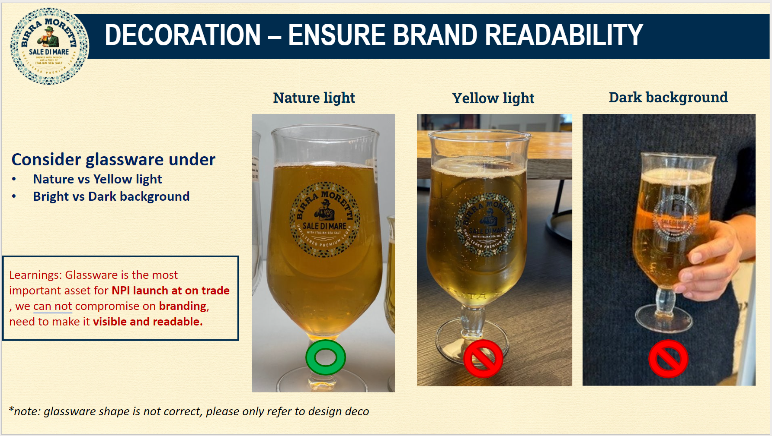

Slide 32
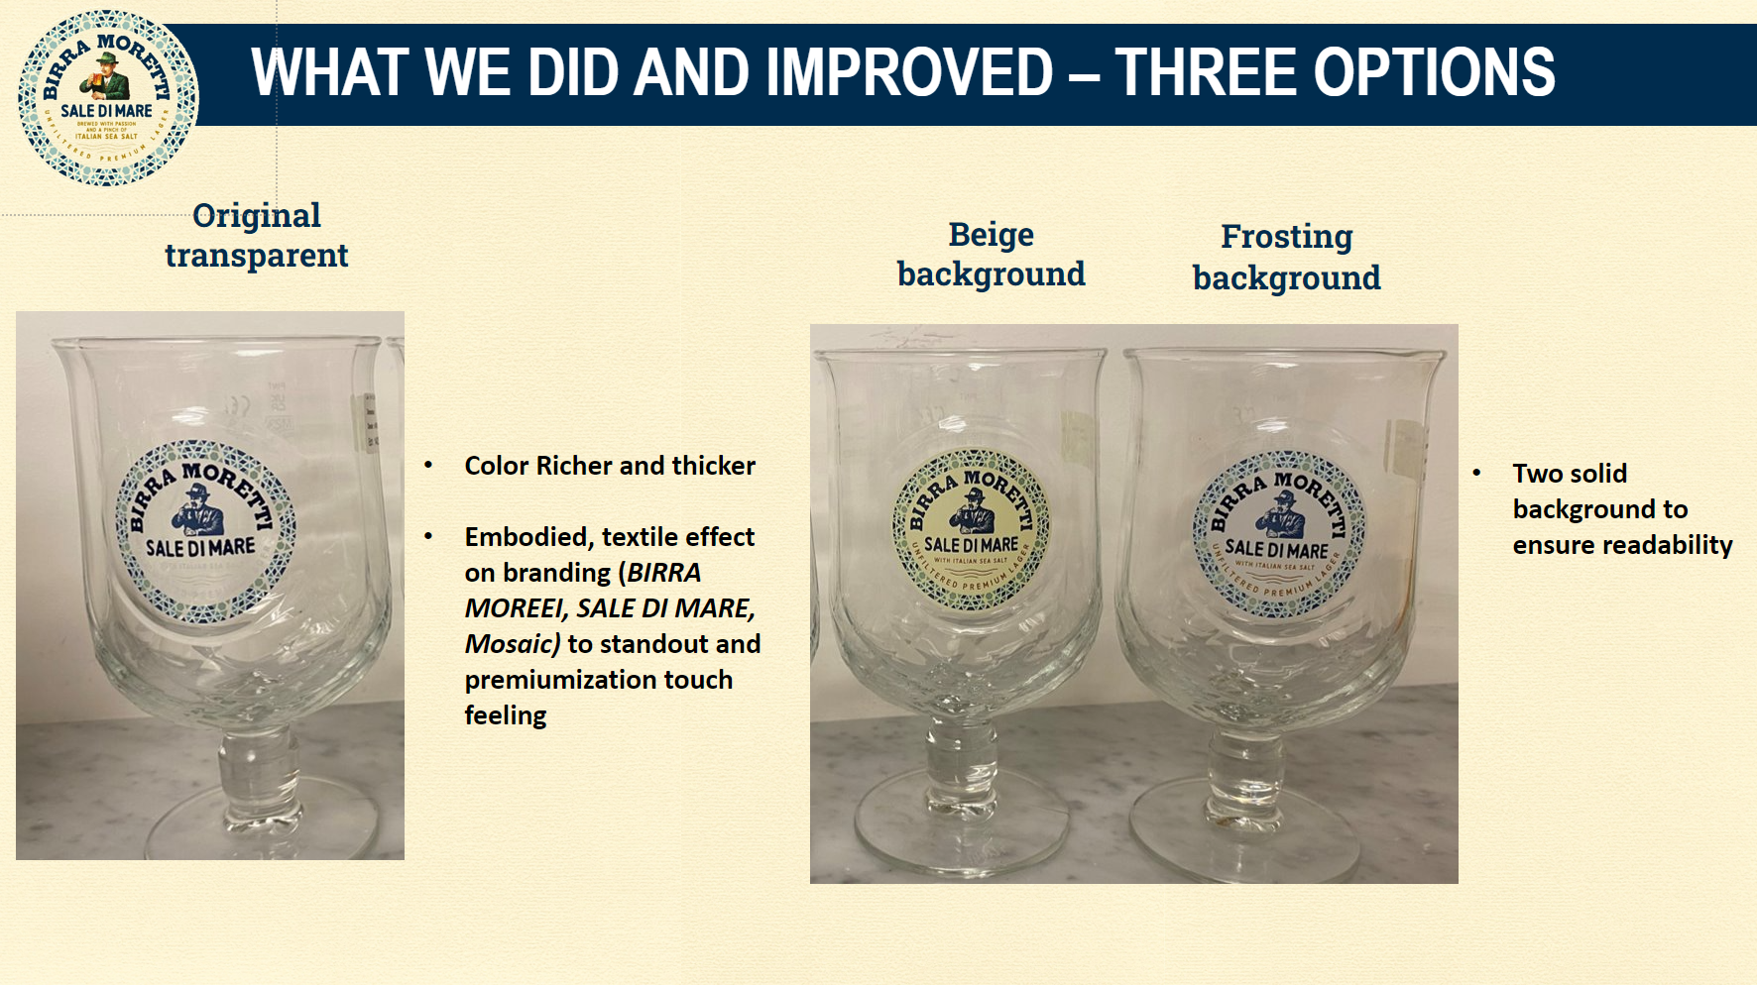

Slide 33
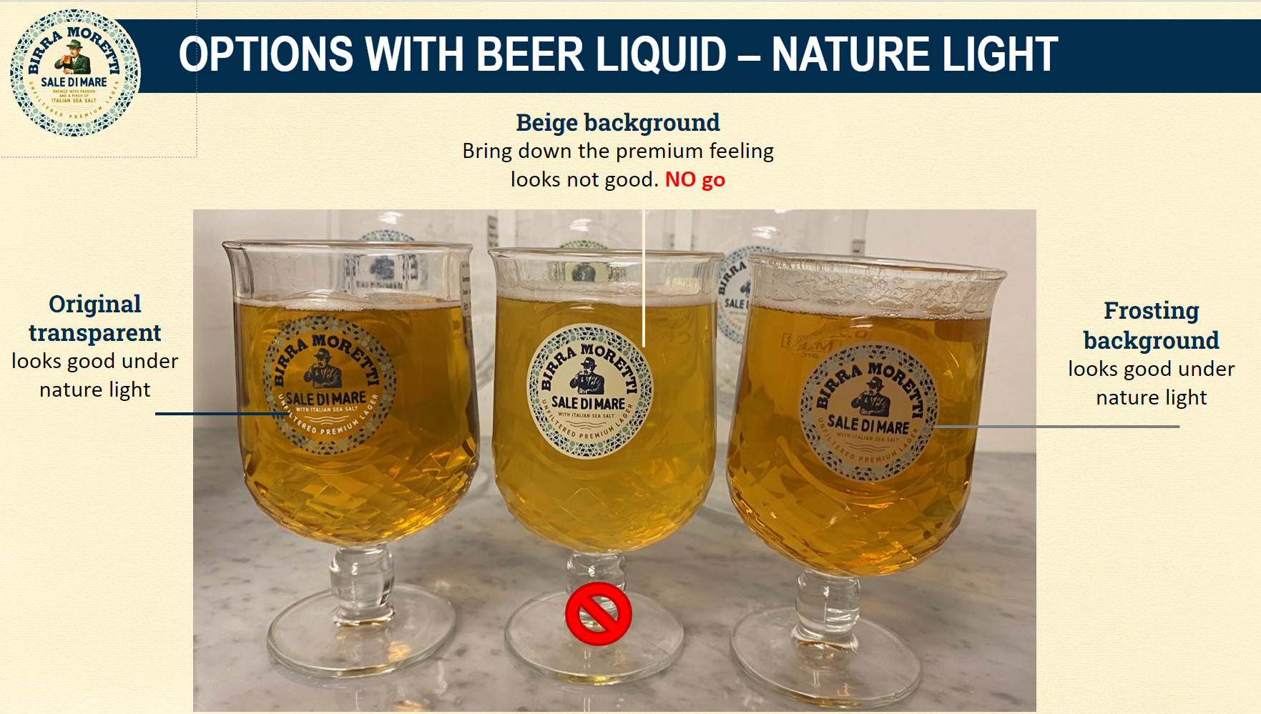

Slide 34
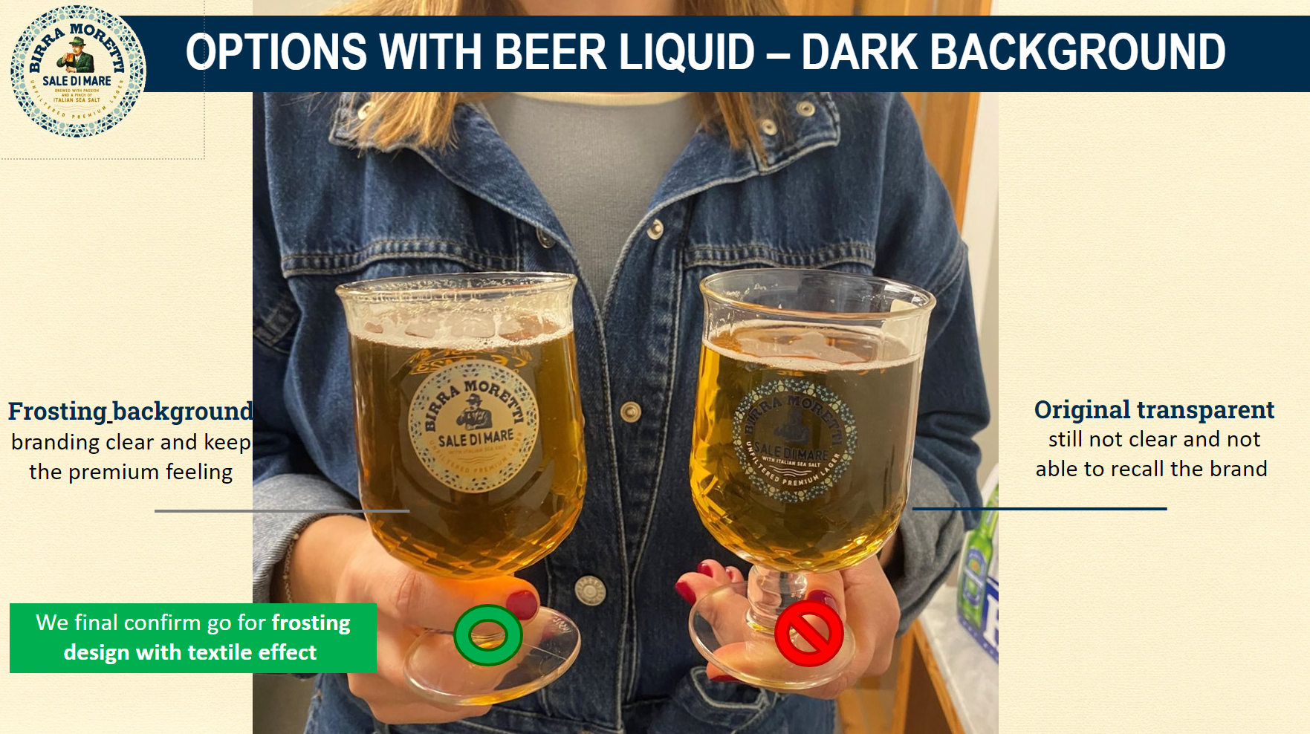

Slide 35
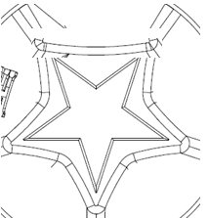
Seam line
Pivot point
of moulds

